Slide 1
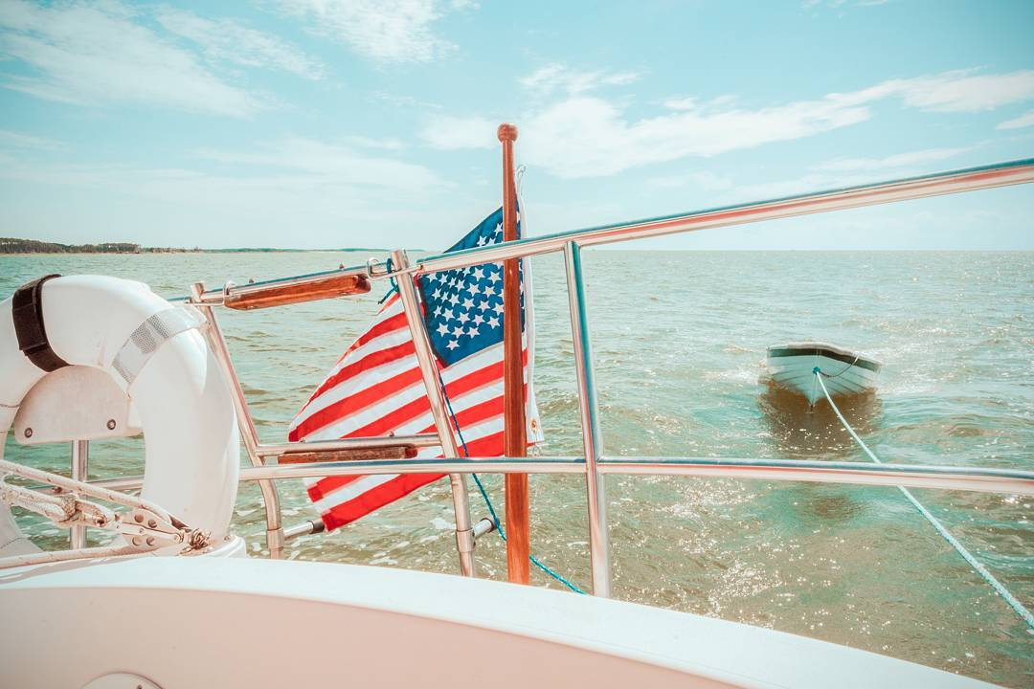
Eastern Shore of Virginia Tourism Commission
2018-2019

Slide 2
Economic
Impact
Of Tourism
2017 Data from VA Tourism Corporation
Fastest growing tourism region in VA for three of last four years
$7.7 million in taxes flowed into ESVA towns/counties from tourism meals, sales & transient occ. tax
$285.5 million spent by tourists
an average of $782,284 per day here on VA’s Eastern Shore
Travel Economic Impact (Expenditures: food, lodging, transport, purchases,
entertainment, recreation; Payroll; Employment;
Direct Travel Related Tax Receipts)

Slide 3
+28%
Visitor Spending
2011 to 2017
Travel Economic Impact (Expenditures: food, lodging, transport, purchases,
entertainment, recreation; Payroll; Employment;
Direct Travel Related Tax Receipts)

Slide 4
+21%
Local Taxes
2013 to 2017
Travel Economic Impact (Expenditures: food, lodging, transport, purchases,
entertainment, recreation; Payroll; Employment;
Direct Travel Related Tax Receipts)

Slide 5
+35%
Tourism Payroll
2011 to 2017
Direct wages, salaries and tips
corresponding to direct
travel-related employment

Slide 6
+18%
Tourism Jobs 2011 to 2017
Source: VTC estimate of direct
travel-related employment
in the locality

Slide 7
Key
Performance
Highlights
260,355 visits to web/blog site
1.3 million Facebook impressions
129 ESVA media stories (2017 Data)
2018 Data from ESVA Tourism Commission
Travel Economic Impact (Expenditures: food, lodging, transport, purchases,
entertainment, recreation; Payroll; Employment;
Direct Travel Related Tax Receipts)

Slide 8
Website Top Pages
Source: 2017 Website data, www.esvatourism.org

Slide 9
88% New
Website New v Returning
Source: Google Analytics

Slide 10
Social Media
Facebook
22,998 likes/follows
Instagram 1,943 followers
#visitesva
4,494
Source: Instagram/Facebook page; ESVA Tourism Commission

Slide 11
2018 Marketing Programs
Consumer
Industry
Regional

Slide 12
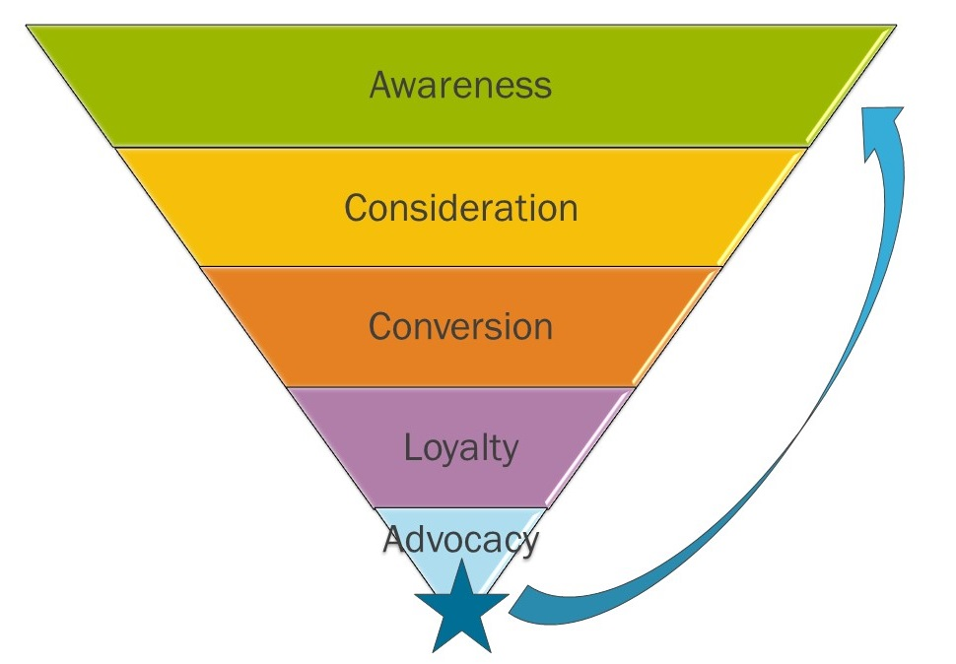
Consumer Marketing

Slide 13
Earned Media aka “PR”
129 media stories
Efforts
VTC – State
ESVTC -- Regional
ESVA towns - Local
ESVA businesses -- Hyperlocal
Four press trips
underwritten by tourism commission

Slide 14
2018 Facebook Marketing
1.3 million impressions
332 posts Organic + paid reach
Top Click post: 1,452 clicks “What Life Is Like Inside The Tiny Town In Virginia With No Cars”
Top Engagement Post: 3,808
“The Virginia Bakery In The Middle Of Nowhere That’s One Of The Best On Earth”

Slide 15
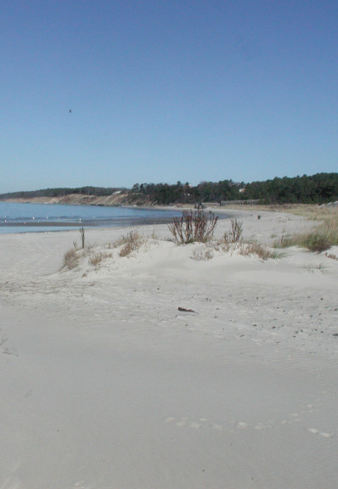
Blog Marketing
54,267 views
13 feature stories published
Organic + paid reach
Content re-published to VTC website
Top post: 8,218 Views “6 Gorgeous Beaches on VA’s Eastern Shore”

Slide 16
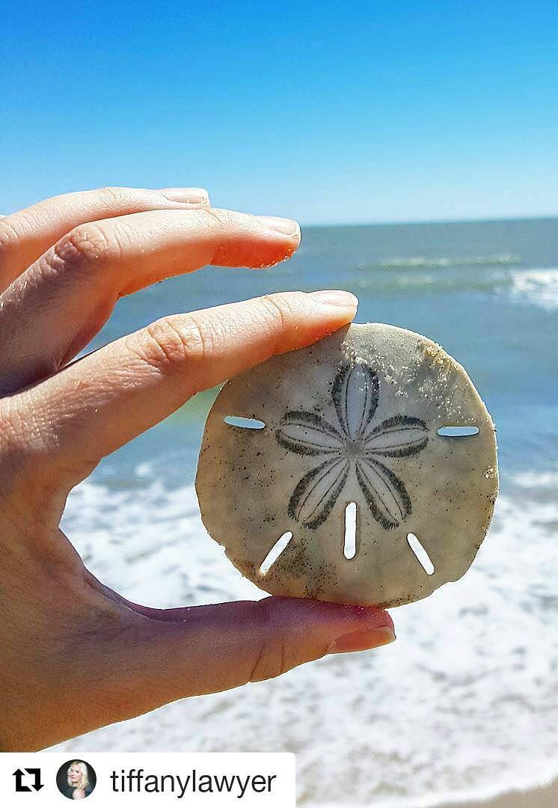
Instagram Marketing
1,943 followers @ #visitesva
Publish 3x per week

Slide 17
Video Marketing
49,468 YouTube views 2009 to date
3,230 Facebook views 2014 to 2017
Top YouTube video: 24,000 views “Visit The Eastern Shore of Virginia”

Slide 18
Search Engine Marketing
70% website visitors from search
80% of that is from Google
Ranking Page One (01/21/2019):
#1 ESVA tourism commission website #2 Nine Best Reasons to Visit (ESVA TC website)
#3 Wikipedia - ESVA
#4 Trip Advisor- ESVA
#5 VTC – Coastal VA - ESVA
#6 5 Small Towns on VA’s ES for Quiet Coastal Retreat (ESVA TC Website)

Slide 19
Website Unique Visitors
235,937
34% are 25 to 44 ages
Food #1 interest
From 1 VA Beach
2 DC
3 Norfolk
4 Chesapeake
5 Suffolk 6 Richmond
7 Cape Charles
8 Newport News 9 New York City
10 Charlottesville

Slide 20
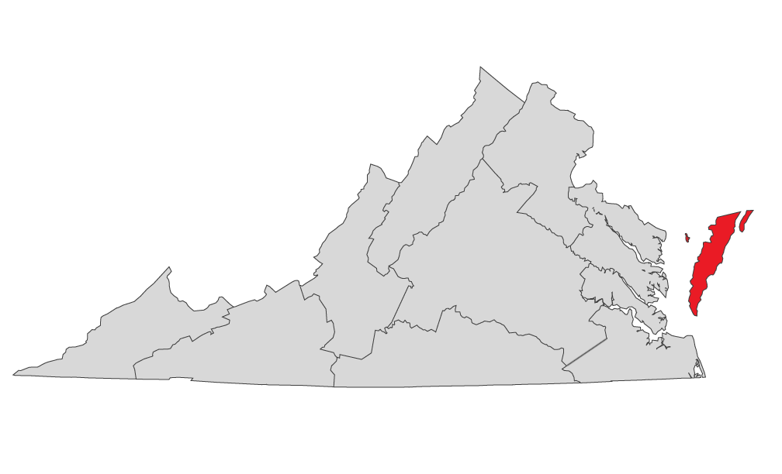
ESVA Industry Programs

Slide 21
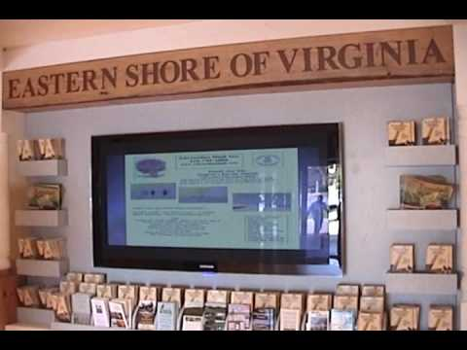
Tourism Industry Programs
Free Partner Marketing
Welcome Center
Print Guide
Web & Blog Sites
Education & Information
Annual Tourism Summit
Annual Fall Workshop
Grant partnerships

Slide 22
Regional Marketing

Slide 23
Regional Marketing
VA Oyster Trail
Coastal VA Tourism Alliance
Artisan Trail
VTC PR Programs
VTC Development Program
VTC Content Distribution
Civil War Trail
American Evolution Trail
Coastal VA Tourism Alliance
ESVA Grant partnership

Slide 24
Contact Info: Eastern Shore of Virginia Tourism Commission Robie Marsh executivedirector@esvatourism.org 757-787-8268

